Slide 1
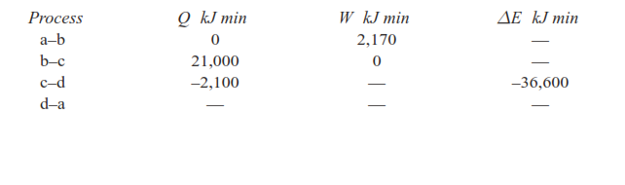
A piston and cylinder machine contains a fluid system which passes through a complete cycle of four processes. During a cycle, the sum of all heat transfers is − 170 kJ. The system completes 100 cycles per min. Complete the following table showing the method for each item, and compute the net rate of work output in kW.

Slide 2
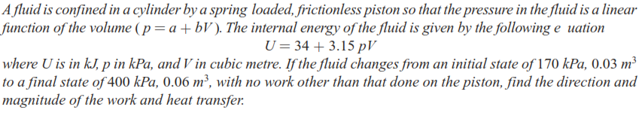

Slide 3
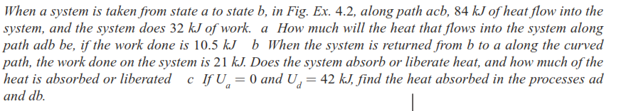
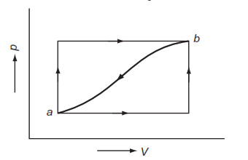

Slide 4
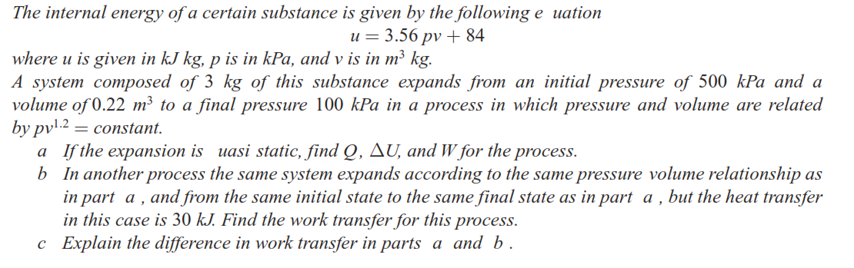

Slide 5
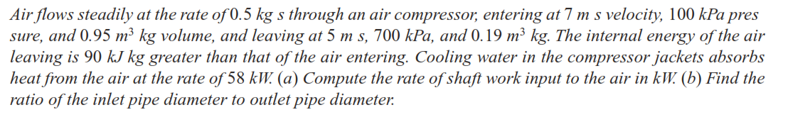

Slide 6
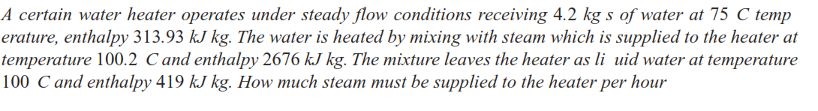

Slide 7
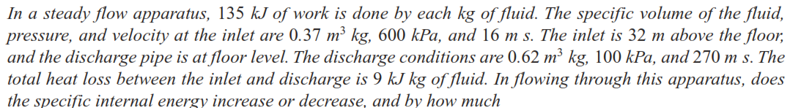

Slide 8
